Slide 1
Secure Web Programming
Lecture 4. Server-side Scripting
PHP & mysql
Amanda.Lunt@utas.edu.au
Soonja.Yeom@utas.edu.au

Slide 2
Topics
Secure Web Programming
Week13
Review
Basic Web Programming
Web Security
Adv. Web Programming
Fundamentals – protocol, CS model, etc.
HTTP Protocols, Storage
Advanced Web Applications
Human Computer Interaction with Web Page Design
Security Issues and Technologies
Session management
Client-side Scripting Language and Document Object Model
Secure Programming and Users
Common Gateway Interface
Server-side Scripting Language and Privilege configuration
Encryption and Authentication
Advanced Security Issues

Slide 3
Review: Dynamic Web page with scripts
It is generated by a web application (scripting languages)
can customize the response on the server to offer personalization
Contents can be changed in response to different contexts or conditions
Client-side scripting
- Possible condition for displaying the content
the type of user interaction (i.e. mouse or keyboard action)
Server-side scripting
- Possible condition for displaying the content
What is submitted
The time of day
The type of submitted value (i.e. login or any submission forms)

Slide 4
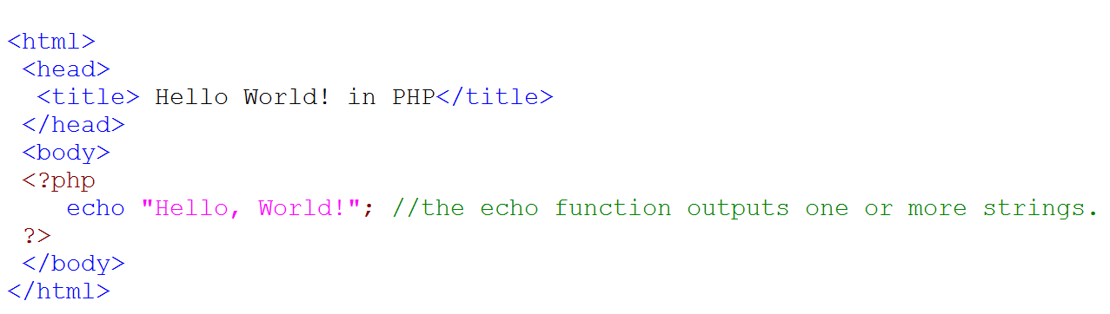
Review: how to use PHP
Save as PHP file (i.e. index.php):
PHP file should save into the server:
For instance, the school server
alacritas.cis.utas.edu.au/~username/

Slide 5
Review: Superglobal variable
Built-in variables containing information from Web server, environment and user input
Example
$_SERVER: an array containing information such as headers, paths, and script locations
$_COOKIE: variables provided to script via HTTP cookies
$_ENV: variables provided to script as part of the server environment.
$_GET: variables provided to script via GET method.
$_POST: variables provided to script via POST method.
$_FILES: variables provided to script via file uploads.
$_SESSION: variables registered in a session.

Slide 6
Today’s lecture
HTML form with server-side scripting (PHP)
HTML– PHP – Database
Connecting to MySQL & phpMyAdmin
How to manipulate database with PHP

Slide 7
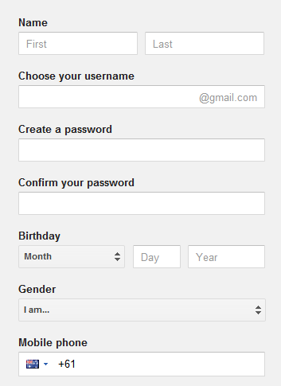
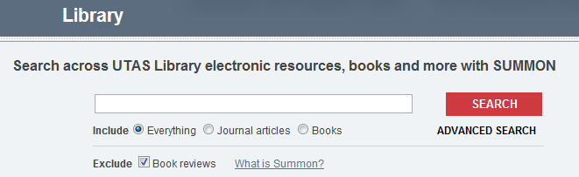

HTML Form
Notes:
.

Slide 8
HTML Form
HTML form
Use <form>, <input> tags
Use for passing data to a server
method attribute: how to send the form-data (GET, POST)
action attribute: where to send the form-data (URL)

Slide 9
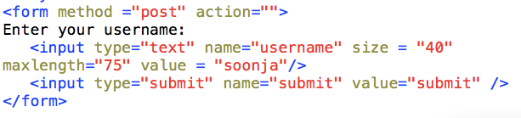

Example
Output

Slide 10
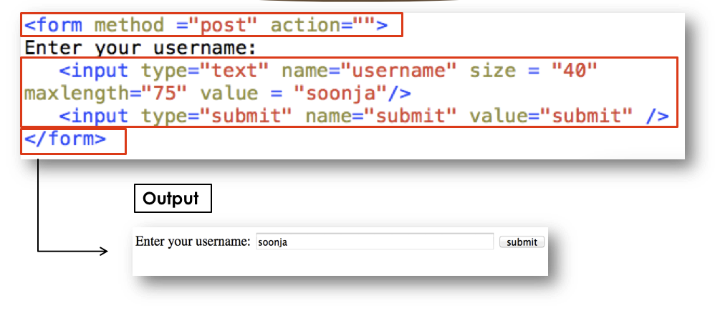
HTML Form – method attribute
HTML form: Use for passing data to a server
method attribute: how to send the form-data
GET : the form data will be sent as url variables
POST: HTTP Post transactions

Slide 11
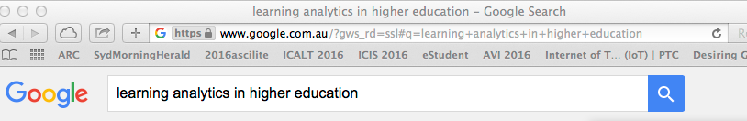
HTML Form – method attribute
HTML form: Use for passing data to a server
method attribute: how to send the form-data
GET : the form data will be sent as url variables
Appends form-data into the URL in name/value pairs (q=something)
The length of a URL is limited
Never use GET to send secure data
Useful for form submissions where a user want to bookmark the result
POST: HTTP Post transactions
Appends form-data inside the body of the HTTP request (data is not shown is in URL)
No length limitations
Cannot be bookmarked

Slide 12


HTML Form with PHP
To receive HTML form input from the server-side:
Use Superglobal variables
Ex) $_GET[ var ] / $_POST[ var ]
Output
After clicking submit button

Slide 13
Client to Server
Web browser
Web Server
PHP
HTML
HTML Form + Super global variable
ex) $_GET, $_POST

Slide 14
Client to Server with HTTP
Web browser
Web Server
PHP
HTML
HTTP
Request message
Response message
Called the request line – 3 parts
Method (e.g. GET, POST)
Uri of request resource
HTTP version being used
Initial Line
Called the status line – 3 parts
HTTP version
Response code
Response phrase
Contain information that allows the client to:
Provide information about itself to the server
Give additional details about the nature of the request that the client is making
Allow the client to have greater control over how its request is proceed and how a response is returned by the server or intermediary
Headers
Contain information about such things as:
the media type of the content sent to the recipient
a new URL that the server is instructing the client to use in place of the one the client initially requested
cookies that the client should store
Blank Line
May contain data that has been submitted from a form
Optional Contents
The actual contents of the resource requested (e.g. the html code)

Slide 15
Client to Server
Web browser
Web Server
PHP
HTML
HTML Form + Super global variable
ex) $_GET, $_POST

Slide 16
Client <-> Server <-> Database
Web browser
Web Server
Database
PHP
?
HTML
HTML Form + Super global variable
ex) $_GET, $_POST
Connection

Slide 17
Database
Collection of data that is related to a particular topic or purpose.
Database Management System (DBMS)
A system that stores and retrieves information in a database.
Databases | PHP Functions
CSV | fgetcsv, fputcsv
XML | SimpleXML
MySQL | mysql, mysqli
SQLite | PDO

Slide 18

Why Database Management System?
Why should I use a DBMS?
Database Management System (a.k.a. DBMS)
Data independence and efficient access.
Reduced application development time.
Data integrity and security.
Uniform data administration.
Concurrent access, recovery from crashes.
User-friendly declarative query language.

Slide 19
Database Model
Database Model is a type of data model that determines the logical structure of a database
 | Hierarchical model | Network Model | Relational Model
Data Structure | Support 1:N or 1:1 relationships (one parent – many children) | Support N:N relationships (many parents – many children) | Support 1:1, 1:N, N:N relationships Relational data structures
Data Manipulation | Support complex and asymmetric retrieve algorithms | Support complex and symmetric retrieve algorithms | Support simple and symmetric retrieve algorithms
Data Integrity | Have lots of constraints to insert, update, or delete. (because of the one parent to children relationship) | Free from any insert, update, or delete anomalies | Free from any insert, update, or delete anomalies

Slide 20
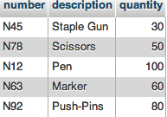
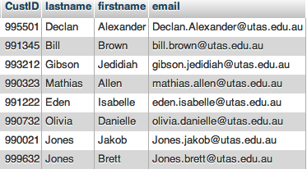
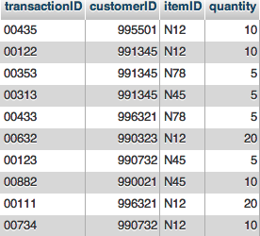
Relational Database
Relational Database model is the most widely used model.
Main concept: relation, basically a table with rows and columns.
All data is represented in terms of tuples, grouped into relations
Related records are linked together with a "key".
item Table
Customer Table
transaction Table

Slide 21
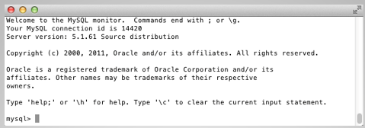

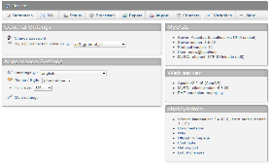
How to use the Database
We will use MySQL as a Database in this unit
How to use (manipulate) the Database
Using terminal – Command line
Use the tool - phpMyAdmin

Slide 22
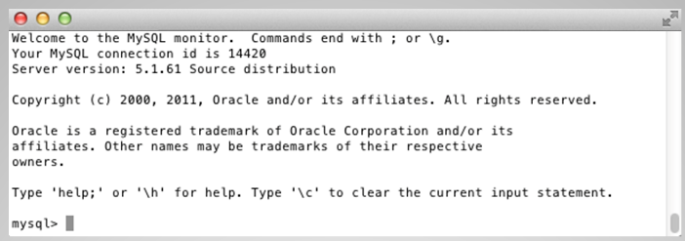
MySQL connection
ssh alacritas.cis.utas.edu.au
<type password>
mysql –u username –p
<type password>

Slide 23
Commands for Database
create a database
delete a database
switch current database to another database
rename a database
enumerate databases
CREATE DATABASE database_name;
DROP DATABASE database_name;
USE database_name;
RENAME DATABASE database_name to new_database_name;
SHOW databases;

Slide 24

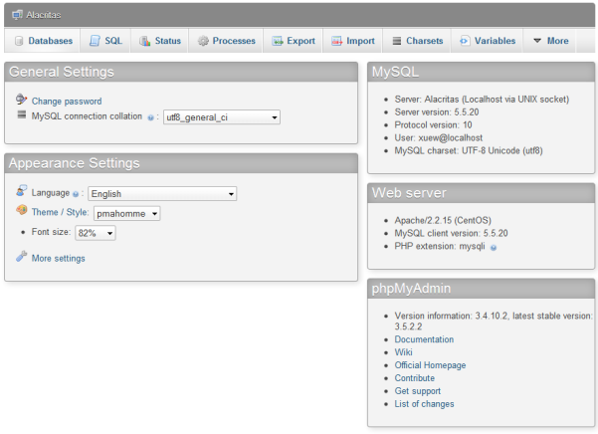
PHPMyAdmin
http://alacritas.cis.utas.edu.au/phpMyAdmin

Slide 25
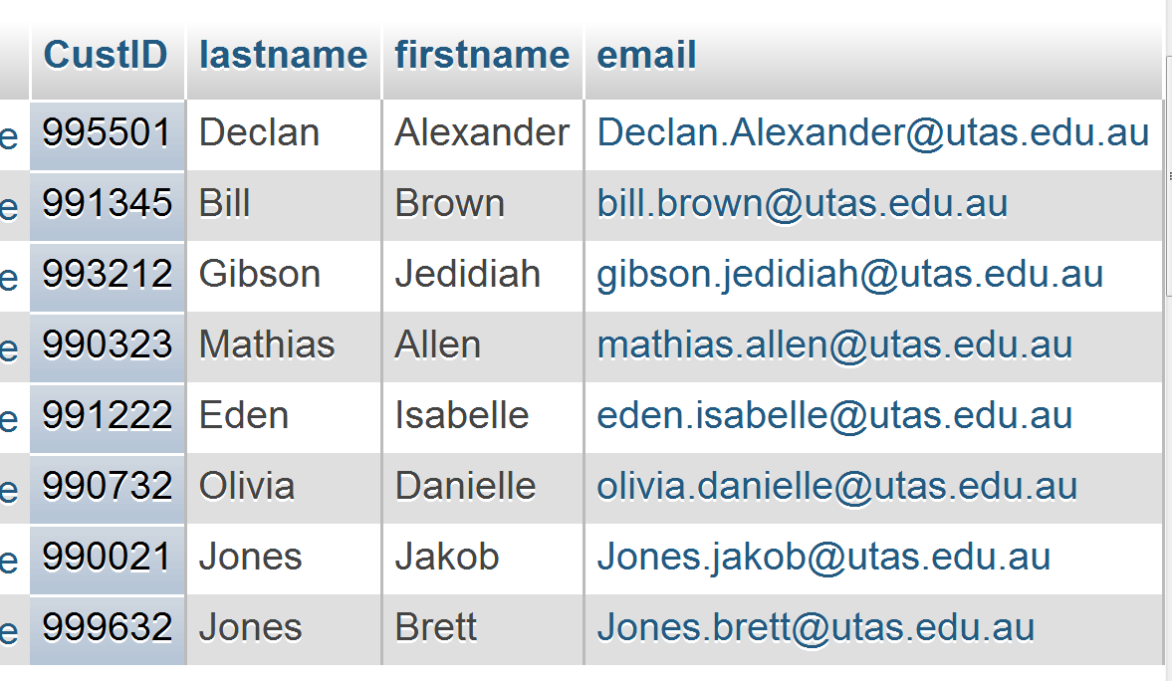
Table in the Database
Column
a set of data elements
Row

Slide 26
Types of Column
numeric
integer, decimal, float, …
string or text
char, varchar, text, longtext, …
BLOB
tinyblob, blob, longblob, …
time and date
time, data, datatime, year, …

Slide 27
Commands for Tables (1)
follow commands must be performed after “use database” command
create a table with definition of columns
example
CREATE TABLE table_name (
column_name column_type [options],
column_name column_type [options],
…
…
);
CREATE TABLE student (
studentID char(6) not null primary key,
firstname text,
lastname text,
address text
);

Slide 28
Commands for Tables (2)
delete a table
rename a table
enumerate tables
describe a structure of a table
DROP TABLE table_name;
RENAME TABLE table_name to new_table_name;
SHOW tables;
DESCRIBE table_name;

Slide 29
Index
An index is data structure that is used to increase the speed of access to data in a table.
Advantages
Query Optimization – searching will be much faster
Uniqueness – Avoiding duplicate row data
Disadvantages
If you use the database to insert the data rather than retrieve (searching) data, it is not efficient

Slide 30
SQL
SQL (structured query language) used for:
Data definition (DDL) : tables and views. Basic operation to convert data model to a database
Data Manipulation (DML): user or program can INSERT, DELETE, UPDATE or retrieve (SELECT) data.
Data integrity: referential integrity and transactions. (keys)
Access control: security

Slide 31
SQL for inserting data
insert a new record
example
INSERT INTO table_name
(column_name, column_name, …)
VALUES
("first_value", "second_value", …);
INSERT INTO student
(studentID, firstname, lastname, address)
VALUES
("012345", "John", "Brown", "123 Main Rd., Moonah");

Slide 32
SQL for updating data
update records
modify contents of selected columns with new values
UPDATE table_name
SET column_name1=expression1,
column_name2=expression2, …
WHERE conditions;

Slide 33
SQL for deleting data
delete records
delete all rows in a table
delete selected rows
DELETE FROM table_name;
DELETE FROM table_name WHERE condition;

Slide 34

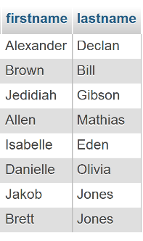
Projections
A projection is a subset of the columns in a table used when only some columns are required or being updated
SELECT `firstname`, `lastname` FROM `customer`

Slide 35
SQL for retrieving : Projections
Retrieve data
projections (selected columns)
display all columns and rows
display specified columns
SELECT * FROM table_name;
SELECT column_name1, column_name2,… FROM table_name;

Slide 36
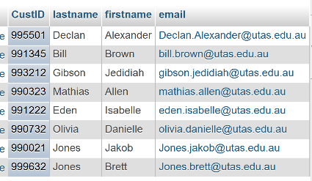
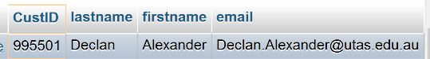
Selections
A selection is a subset of the rows in a table
typically, those rows that match some selection criteria
SELECT * FROM `customer` WHERE `custID` = 995501

Slide 37
SQL for retrieving : Selections
retrieve data
selections (selected rows(record))
display specific rows with all columns
display specific rows with specific columns
condition examples
SELECT * FROM table WHERE condition;
SELECT column_name1, column_name2, … FROM table_name WHERE condition;
column_name="value"
column_name<"value"
column_name>="value"

Slide 38
Relational Database
All we learned today was Relational Database
It has the following characteristics (Remember?):
information is stored in tables
can be multiple tables in a single database
each table consists of a number of rows and columns
column (field) : the values held for each item
row (record) : one for each item in the table
Each row is identified uniquely by key.
Information is extracted by a query.
tables may be related to each other via common data values (eg., a common column)

Slide 39
Multiple Tables in Relational Database
Primary key
Customer Table
item Table
transaction Table
Primary key
Foreign key
Foreign key

Slide 40
Key
an element for identifying a specific information
Two types of Key
Primary key
an element for identifying uniquely each record in the table
eg., student ID but not family name
consists of one or more columns that uniquely identify each row of a table
must be unique each value in primary key
Foreign key
a column in one table that establishes a relation to the primary key in another table
Example: ‘student_id’ in ‘student’ table can be declared as a foreign key of ‘score’ table.

Slide 41
Creating Databases
Use a text editor
Pipe your file into MySQL using Unix
Use <username>;
Drop tables;
Create your tables
Add content to the tables
mysql -t –u <username> -p –f < TextFile.sql

Slide 42
HTML – PHP - MySQL
Web browser
Server
Database
PHP
MySQL
HTML
HTML Form + Super global variable
ex) $_GET, $_POST
MySQL connection

Slide 43
Connecting PHP to MySQL
PHP supplies many built-in functions to interact with a MySQL.
Steps for connecting PHP to MySQL
connect to a database
transfer a query to a database and receive results
process or display results
close the connection

Slide 44
Step (1)
Connect to a database
Object-Oriented style (we use this style for this unit)
Procedural style
Returns error message if it fails to connect to MySQL.
$mysqli = new mysqli($hostname,$username,$password,$dbname);
$mysqli=mysqli_connect($hostname,$username,$password,$dbname);
if(mysqli_connect_errno($mysqli))
{
echo “Failed to connect to MySQL ”.mysqli_connect_error();
}

Slide 45
Step (2)
Transfer a query and retrieve results
Object-Oriented style (we use this style for this unit)
Procedural style
$query="SELECT * FROM `table_name`";
$result = $mysqli->query($query);
$query="SELECT * FROM `table_name`";
$result = mysqli_query($mysqli, $query);

Slide 46
Step (3)-1
Process or display results
Object-oriented style (we use this style for this unit)
numeric array
associative array
numeric array and associative array
$row=$result->fetch_array(MYSQLI_NUM);
$row=$result->fetch_array(MYSQLI_ASSOC);
$row=$result->fetch_array(MYSQLI_BOTH);

Slide 47
Step (3)-2
Process or display results (2)
Procedural style
numeric array
associative array
numeric array and associative array
$row=mysqli_fetch_array($result,MYSQLI_NUM);
$row=mysqli_fetch_array($result,MYSQLI_ASSOC);
$row=mysqli_fetch_array($result,MYSQLI_BOTH);

Slide 48
Step (4)
Close the connection
Object-Oriented style (we use this style for this unit)
Procedural style
$mysqli->close();
mysqli_close($mysqli);

Slide 49
Thank you
Any Questions

